Slide 1
Time dependent modelling

Slide 2
Topics
Time dependent travel time model
Time dependent shortest path problem

Slide 3
Motivation
Traditional problems assume time-invariant travel time
Neglect impact of seasonality of traffic, morning/evening peak.
Ignore unexpected events, like weather, accidents, etc.
No consideration of the characteristics of the road segment, e.g., highway, arterial road, etc.
Leads to research in problems with time-dependent travel times
Time dependent shortest path problem
Time dependent travelling salesman problem
Time dependent vehicle routing problem

Slide 4
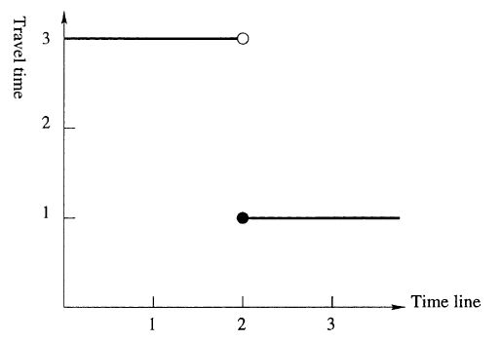
Time dependent travel time model
Model 1: stepwise travel time function with discretized time zones
A
At Time 1
Departure of A
A
B
At Time 2
Departure of B
A
B
At Time 3
Arrival of B
Problem? Violation of FIFO!

Slide 5
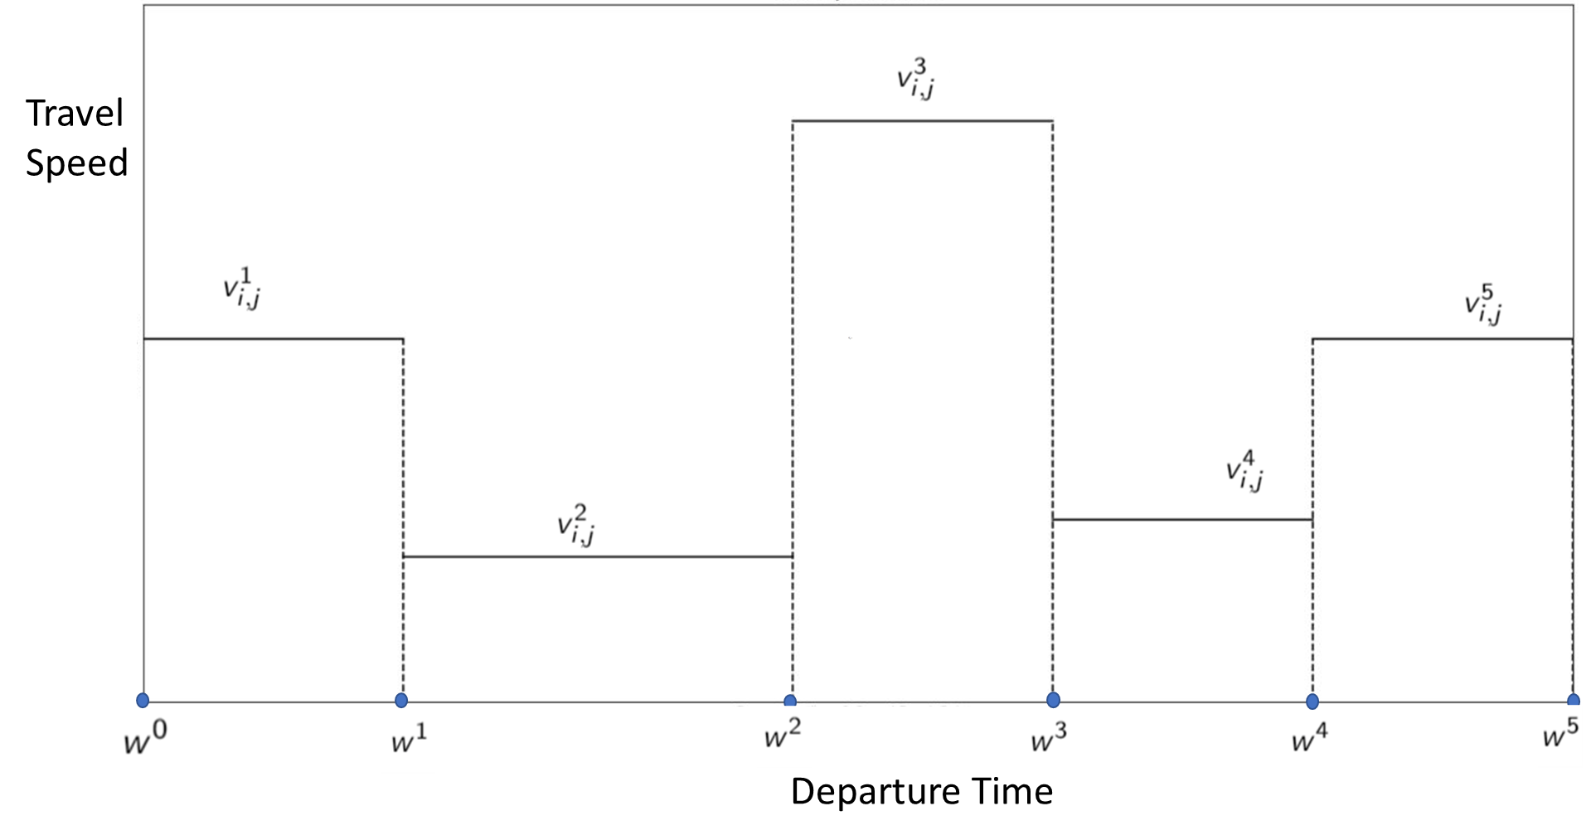
Model 2: Stepwise travel speed function
Speed profile for each arc
Discretized time zones
Constant travel speed within the time zone
Piecewise linear travel time
FIFO principle

Slide 6
Example of travel time calculation
Travel profile and speeds as given in the table.
The distance is 7 and the departure time is 1.
Total travel time is 1 + 1 + 1 + 0.5 = 3.5. Arrival time is time 4.5
Time zone | Start time | End time | Travel Speed | Time travelled | Distance Travelled | Distance to go
1 | 0 | 2 | 1 | 1 | 1 | 6
2 | 2 | 3 | 2 | 1 | 2 | 4
3 | 3 | 4 | 3 | 1 | 3 | 1
4 | 4 | 5 | 2 | 0.5 | 1 | 0
5 | 5 | 7 | 1

Slide 7
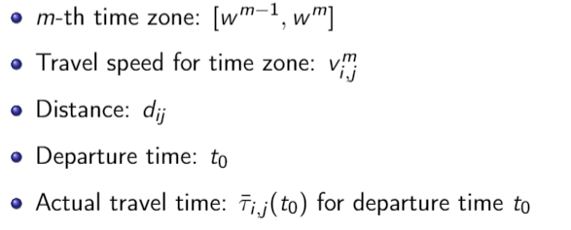
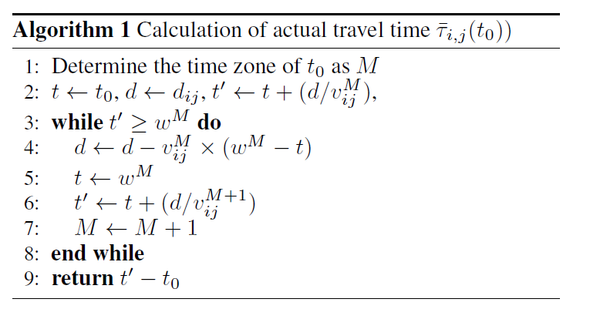
Travel time calculation algorithm

Slide 8
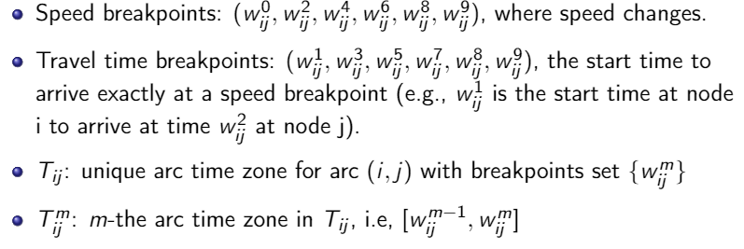
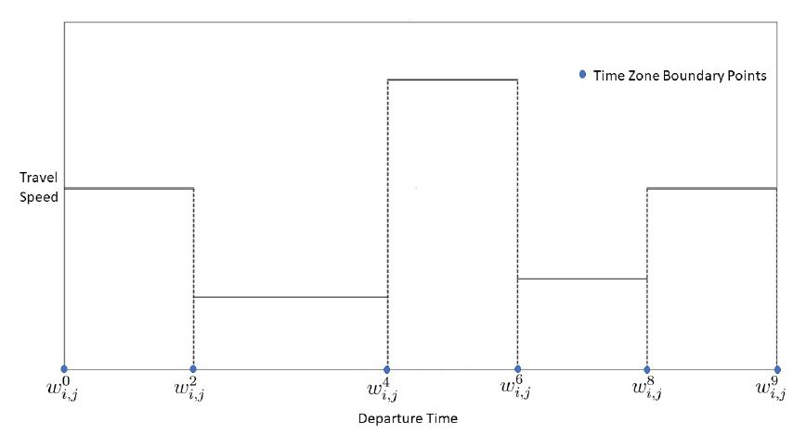
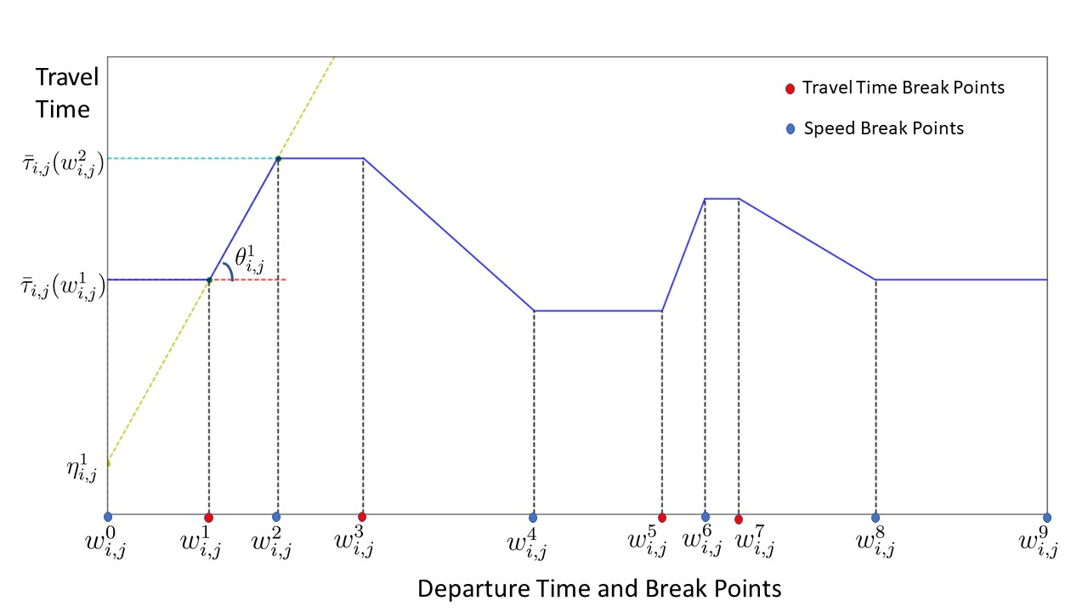
Breakpoints

Slide 9
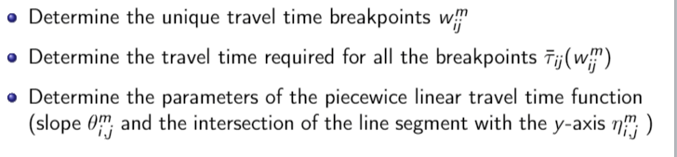
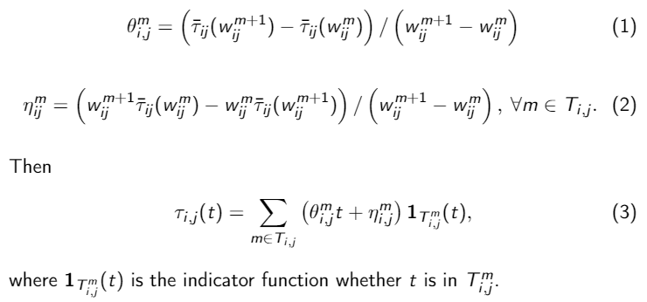
Time Dependent Travel Time function

Slide 10
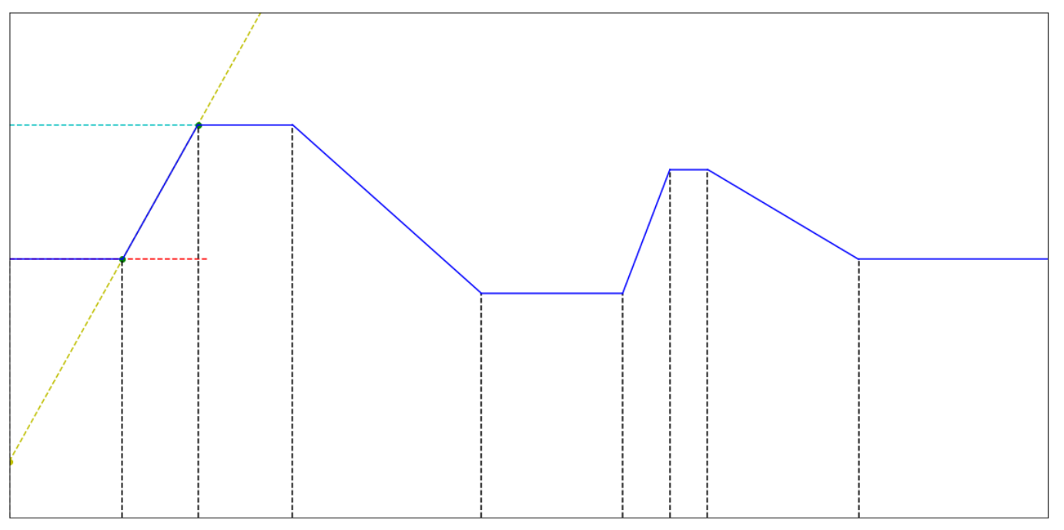
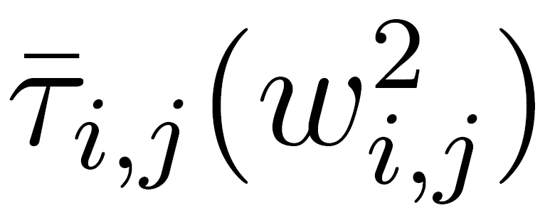
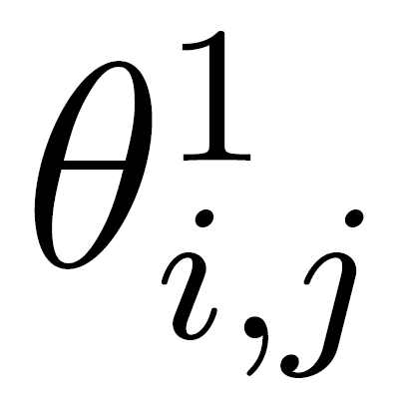
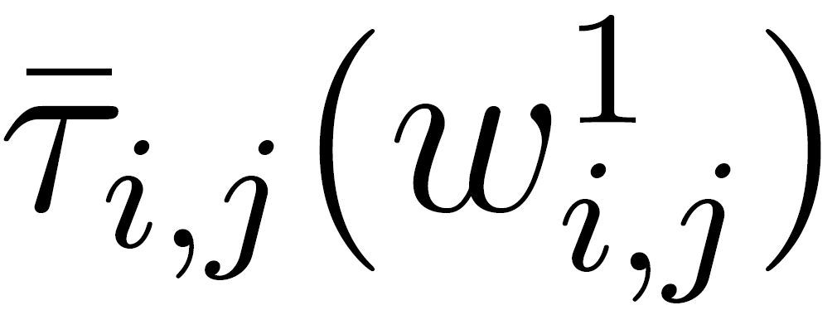
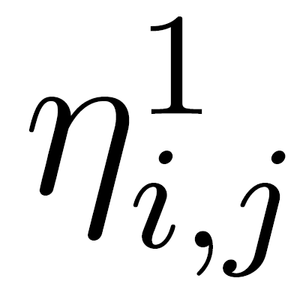
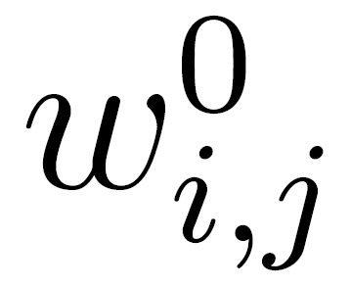
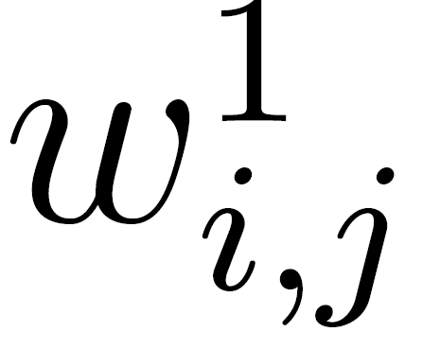
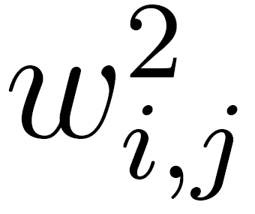
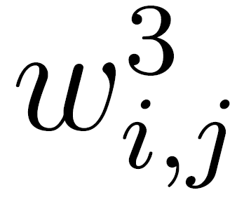
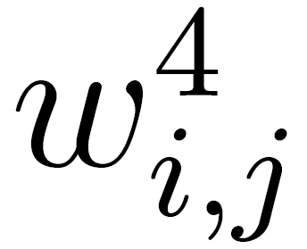
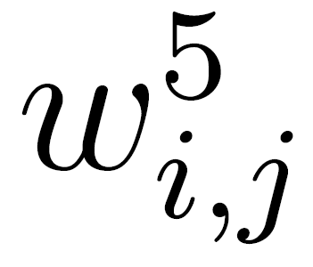
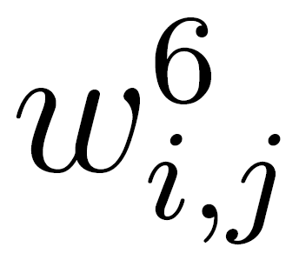
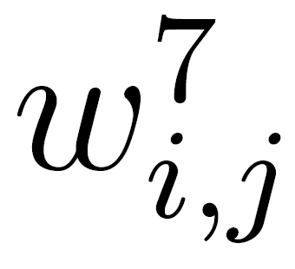
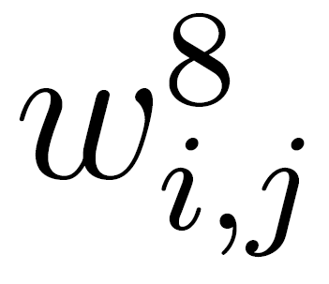
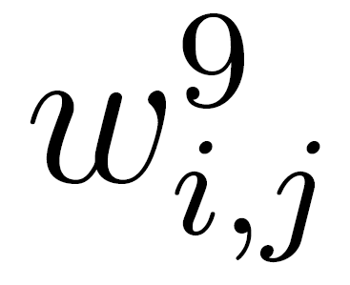
Travel time function for arc (i,j)
Travel
Time
Departure Time and Break Points

Slide 11
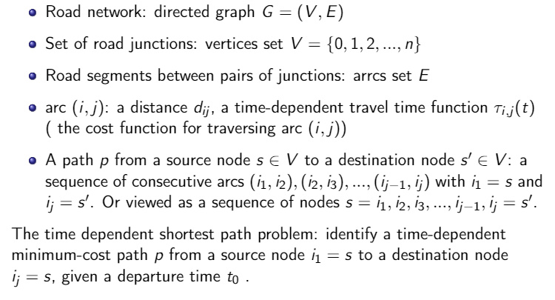
Time dependent shortest path problem (TDSPP)

Slide 12
Revision: Dijkstra's algorithm
Dijkstra's algorithm - is a solution to the single-source shortest path problem in graph theory.
Works on both directed and undirected graphs. However, all edges must have nonnegative weights.
Approach: Greedy
Input: Weighted graph G={E,V} and source vertex v∈V, such that all edge weights are nonnegative
Output: Lengths of shortest paths (or the shortest paths themselves) from a given source vertex v∈V to all other vertices

Slide 13
Dijkstra's algorithm - Pseudocode
dist[s] ←0 (distance to source vertex is zero) for all v ∈ V–{s} do dist[v] ←∞ (set all other distances to infinity) S←∅ (S, the set of visited vertices is initially empty) Q←V (Q, the queue initially contains all vertices) while Q ≠∅ (while the queue is not empty) do u ← mindistance(Q,dist) (select the element of Q with the min. distance) S←S∪{u} (add u to list of visited vertices) for all v ∈ neighbors[u] do if dist[v] > dist[u] + w(u, v) (if new shortest path found) then dist[v] ← dist[u] + w(u, v) (set new value of shortest path)
(if desired, add traceback code)
return dist

Slide 14
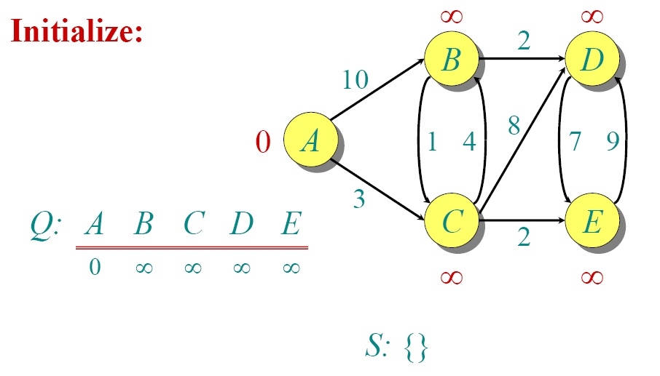
Dijkstra Animated Example

Slide 15
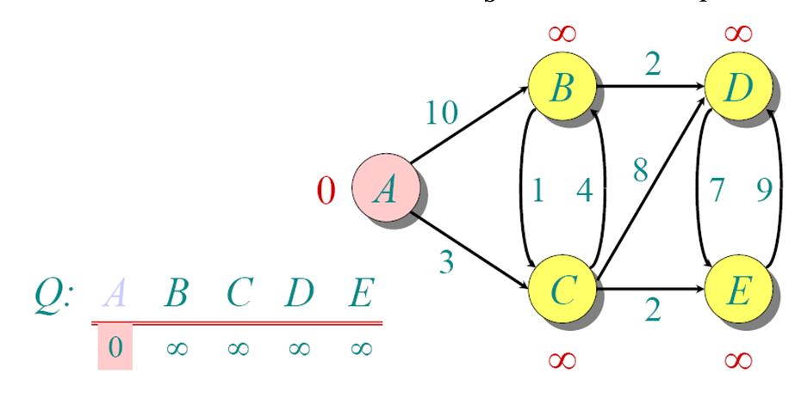
Dijkstra Animated Example

Slide 16
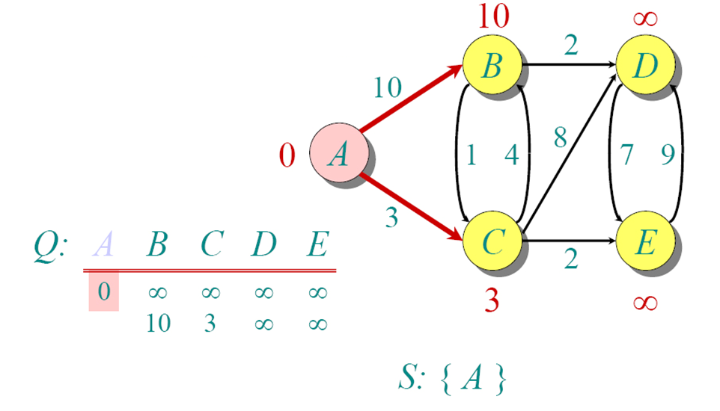
Dijkstra Animated Example

Slide 17
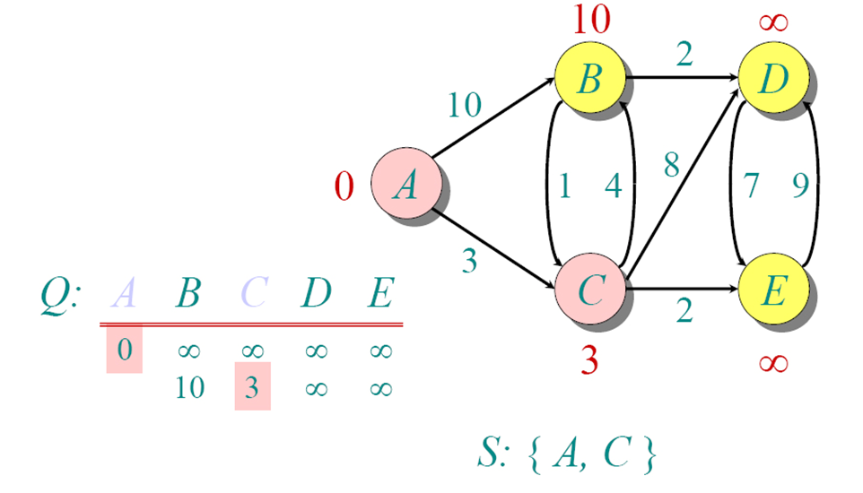
Dijkstra Animated Example

Slide 18
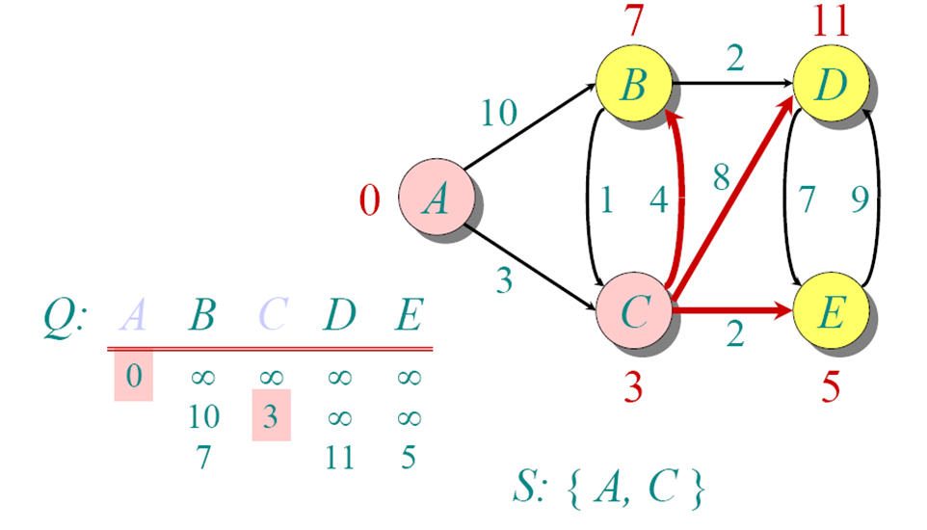
Dijkstra Animated Example

Slide 19
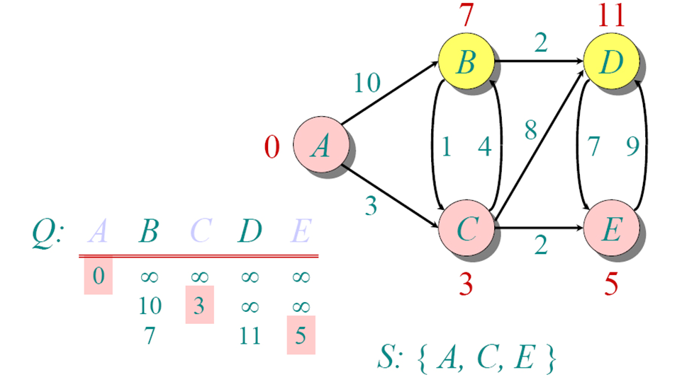
Dijkstra Animated Example

Slide 20
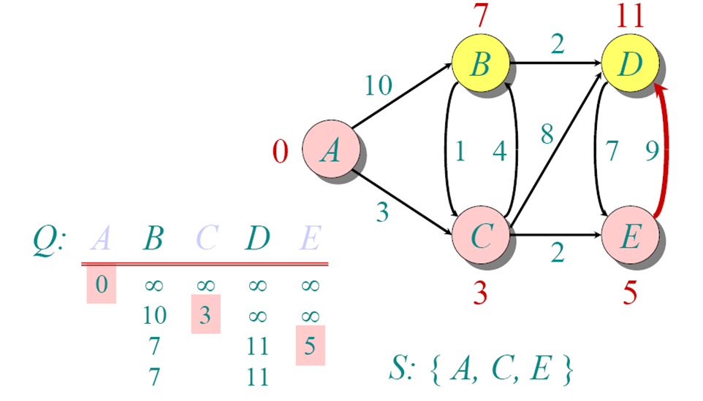
Dijkstra Animated Example

Slide 21
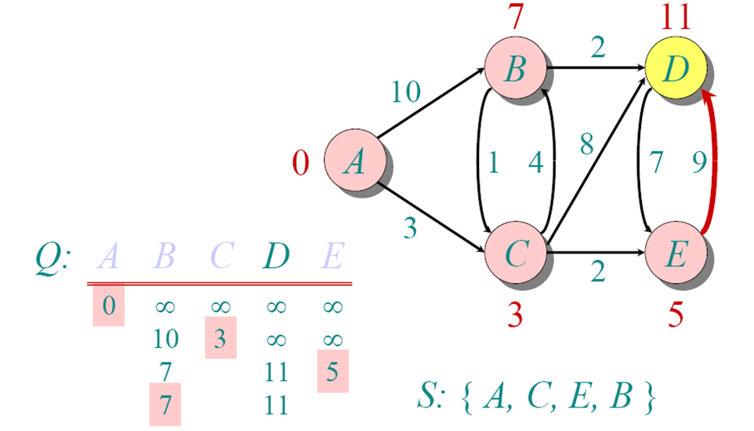
Dijkstra Animated Example

Slide 22
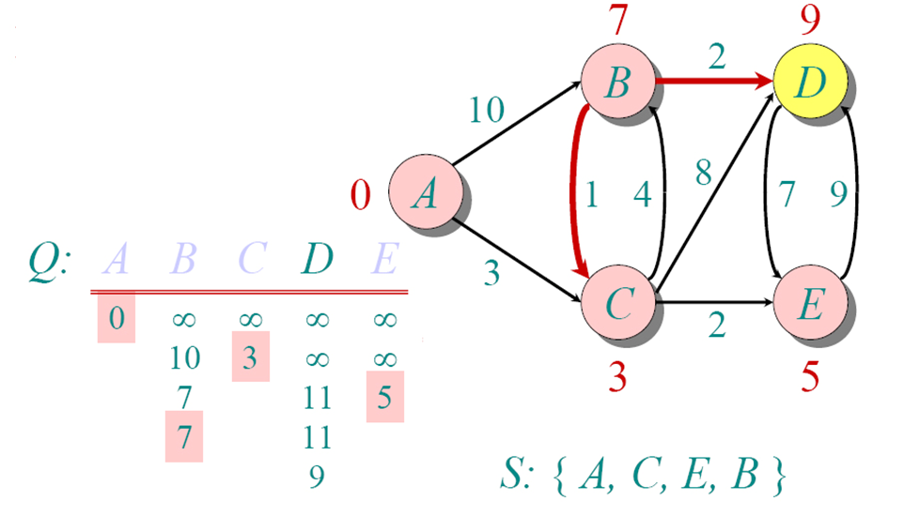
Dijkstra Animated Example

Slide 23
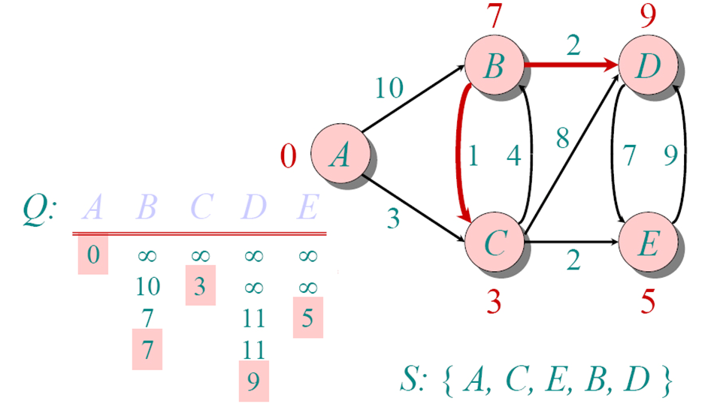
Dijkstra Animated Example

Slide 24
Time-dependent Dijkstra's algorithm - Pseudocode
t[s] ←t₀ (distance to source vertex is zero) for all v ∈ V–{s} do t[v] ←∞ (set all other distances to infinity) S←∅ (S, the set of visited vertices is initially empty) Q←V (Q, the queue initially contains all vertices) while Q ≠∅ (while the queue is not empty) do u ← mindistance(Q,dist) (select the element of Q with the min. distance) S←S∪{u} (add u to list of visited vertices) for all v ∈ neighbors[u] do if t[v] > t[u] + τ_{(u, v)} (t[u]) (if new shortest path found) then t[v] ←t[u] + τ_{(u, v)} (t[u]) (set new value of shortest path)
(if desired, add traceback code)
return dist

Slide 25
Question:
In the TDSPP, t₀ is given to find the minimum cost path. What if start time is not given, and you are asked to find the best time with the minimum cost path?

